Slide 1

IOT BASED TEMPERATURE AND HUMIDITY MONITORING SYSTEM FOR SMART HOME
BATCH- 6
STUDENT DETAILS :-
N.Sree Swarna (192119038)
E.Hema Sree (192125021)
R.RupaSriDevi (192110092)

Slide 2
INTRODUCTION:-
we will use this project in monitoring the temperature and humidity. By using the Blynk app.
The main domain of this project is IoT enabled smart temperature and humidity sensing system. This is very helpful to monitor the temperature and humidity in the HOME.
Uses :
Monitoring temperature
Monitoring humidity

Slide 3
AIM AND OBJECTIVES:-
TO MEASURE THE TEMPERATURE OF AMBIANCE.
TO MEASURE THE HUMIDITY OF AMBIANCE.
TO MEASURE THE TEMPERATURE AND HUMIDITY IN THE HOME USING A MOBILE PHONE FROM ANYWHERE.

Slide 4
Components used:-
NODEMCU ESP8266 WIFI Development board.
Connecting wires.
DHT11 sensor.

Slide 5
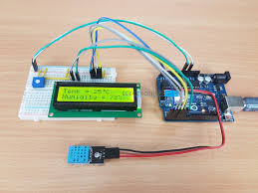
What is temperature and humidity sensor?
Thermo-hygrometer is a device that gives you a measurement of the temperature and humidity of a place with one device. They prove to be very important in fields where temperature and humidity play an important role such as breweries and fermentation units, pharmaceutical incubators, plant growth chambers, etc.
Thermometers can provide accurate temperature information. A standard thermometer that measures the entire range of foreseeable conditions in a building is satisfactory. Humidity indicator strips or color cards are an inexpensive humidity-monitoring device.

Slide 6
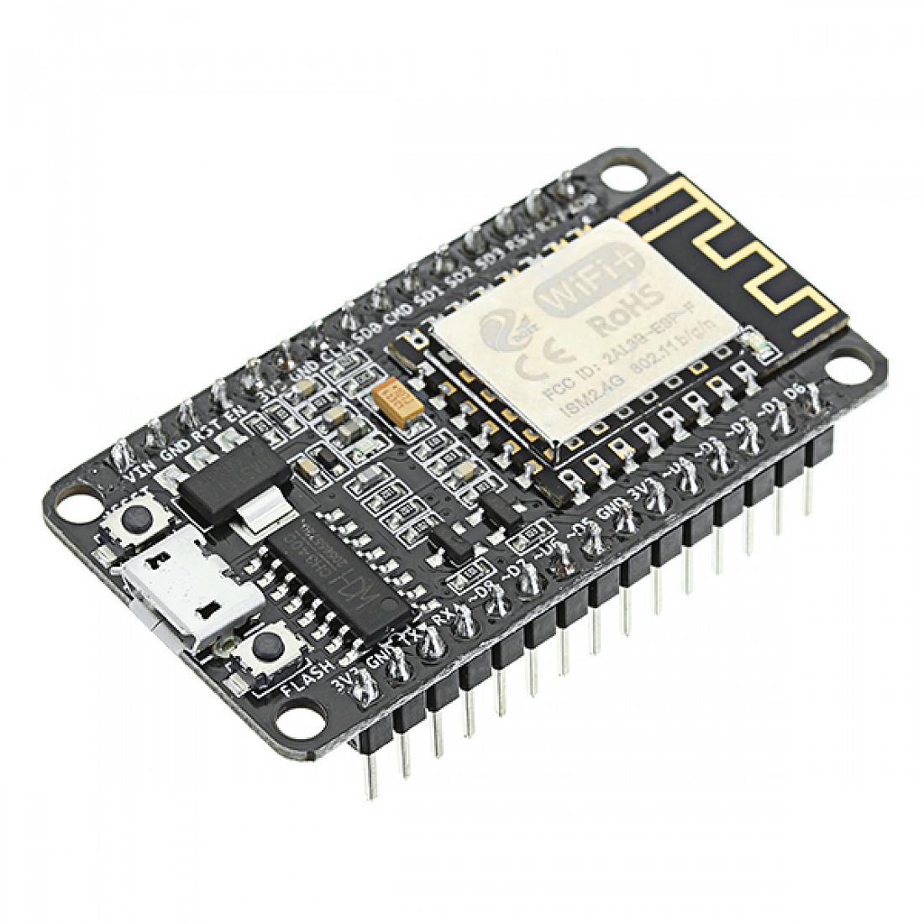
COMPONENTS DESCRIPTION
NODEMCU ESP8266 CH340 WIFI Development board
It is a highly integrated chip that is used to connect with Wi-Fi networking solutions.
It is a powerful onboard processing and storage capabilities chip. It is capable of integrated sensors and other application-based devices

Slide 7
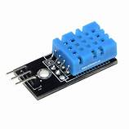
Temperature and humidity sensor
A sensor that senses the temperature in the atmosphere is called a temperature sensor.
A sensor that senses the humidity in the atmosphere is called a humidity sensor.

Slide 8
Why particularly this component
ESP8266 wifi module was particularly used in this project because it is easy to connect with wifi and with the blink app.
Particularly the dht11 sensor is used in this project because it consists of both
Sensors are temperature sensors and humidity sensors at and low cost.

Slide 9
Alternatives :
Compared with Arduino UNO and ESP8266 wifi module was particularly used in this project because it is easy to connect with wifi and with the blink app and also less cost when compare to Arduino UNO
Particularly the dht11sensor is used in this project because it consists of both
Sensors are temperature sensor and humidity sensor and saving the power double sensors are attached at one dht11 sensor

Slide 10
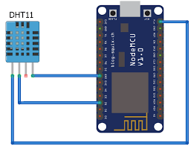
circuit diagram

Slide 11
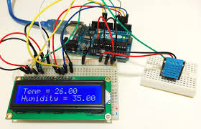

Slide 12
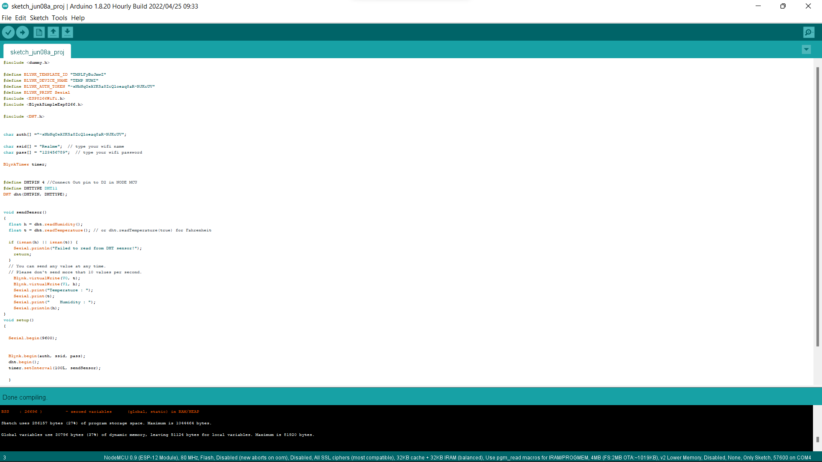
Code/IDE/sample

Slide 13
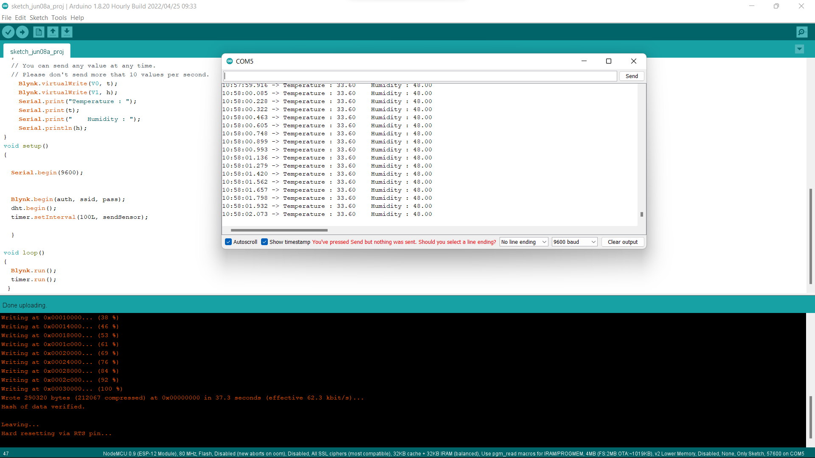
Screenshot output:

Slide 14
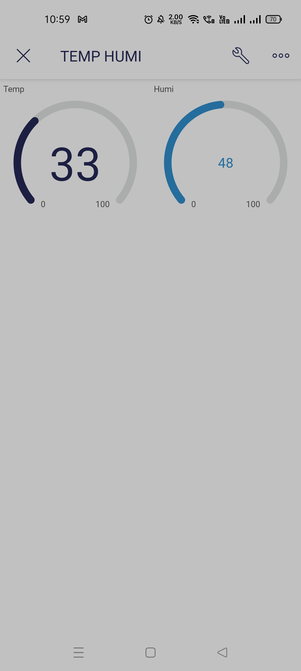
Output photo

Slide 15
Limitation :
The thermistor is not suitable for a large Temperature range.
Non linearity.
Least stability.
Low voltage.

Slide 16
Problem faced:
We faced a problem the board is not compactable to my laptop.
To compile the code we faced a lot of errors in the Arduino simulation.
While connecting the circuit to the device.

Slide 17
Future scope:
Embrace the digital-focused future with our comprehensive portfolio of advanced smart sensor technologies for monitoring and controlling position, pressure, and temperature.
Our mission is to actively develop and expand our offering with new intelligent sensor technologies that satisfy the demands of today’s applications – and anticipate the needs of tomorrow.

Slide 18
Reference :
G. Moggs, Z. Szilagyi, T. Stanislav and S. Folia. "An HTTP-based environmental monitoring system using power harvesting."2017 21st International Conference on System Theory, Control, and Computing Sinaia. 2017. pp. 845 pp.845848. doi:10.1109/ICSTCC.2017.8107142.
B. K. Moharana, P. Anand, S. Kumar, and P. Kodali. "Development of a loT-based Real-Time Air Quality Monitoring Device," 2020 International Conference on Communication and Signal Processing (ICCSP), Chennai. India. 2020, 10.1109/1CCSP48568.2020.9182330.
131 S. Saha and A. Majumdar, "Data center temperature monitoring withESP8266 based Wireless Sensor Network and a cloud-based dashboard. with the real-time alert system." 2017 Devices for Integrated Circuit (DevIC). Kalyani. 2017. 10.1109/DEVIC.2017.8073958. pp. 307-310

Slide 19


